Slide 1
Review and Career Conversation Training for Managers
Slide Deck

Slide 2

Agenda
Aims, introductions and housekeeping
Context, framework and preparation
Enabling quality conversations
Assessing performance, potential and readiness
Ratings and evidence
Giving feedback
Objective setting and development planning
Recording and utilising outcomes
Reflections, Q&A and next steps

Slide 3

Aims
Familiarisation with the organisation’s conversation framework
Focus on how to have effective, high quality conversations
Practice giving feedback on what people do and how they behave
Exploring development options
Setting individual goals linked to the organisation’s strategy
Plan a conversation for somebody in your team

Slide 4

Introductions
Your name
Your team
How many individuals in your team
One thing you’d like to get from today

Slide 5

Background and context
The quality of the conversation: supportive, developmental, constructive, motivational and relevant
Clarity – goals, objectives and aspirations
Understanding behavioural expectations
Ensuring staff feel valued
A continuous process
Connecting staff to our vision, values and strategy

Slide 6
Recap on our priorities
Everybody, irrespective of service, band, profession or characteristics has a conversation that focuses on their potential and career, not just their performance
Leaders are skilled in holding talent conversations and signposting individuals to support/opportunities where appropriate
There are clear development offers in place to sustain and grow the workforce
Pipeline visibility – there is an understanding of the capability and readiness of individuals to fulfil their aspirations and/or critical roles
Integrated with and aligned to our other OD interventions, locally, regionally and nationally

Slide 7
Why it’s important
Engaged employees are characterised by:
Belief and pride in their organisation
Commitment to improve outcomes
Understanding of the whole organisation beyond their job
Respect for colleagues
“willingness to go the extra mile”
Good conversations ensure greater mutual understanding between people, more opportunities to give praise, better clarity of focus and increased engagement

Slide 8
Why it’s important
“Feedback of the interpersonal kind is a minefield of misunderstandings and emotional conflict. In a 2011 survey, one in four people said they hated the annual review more than anything else in their jobs; 55% thought theirs was unfair or inaccurate”.
Oliver Burkeman 2014

Slide 9
Our framework
Insert a picture of your conversation tool and/or provide a list of what’s new/different

Slide 10
Our framework
Performance
Key achievements
Potential
Agility
Readiness
Aspirations
Ready Now / not ready
6 – 12 months
1 – 2 years etc.
Stretch behaviours
Demonstration of values/behaviours
Strengths
Career goals
Appetite/Motivation
Delivery of objectives
Happy what I’m doing
Next steps

Slide 11
Role and responsibilities
Brief the staff you are holding conversations with
Talk to them about preparation
Book (and stick to) time in the diary
Encourage them to take ownership of their career and development
Support them to investigate options
Report completion via X

Slide 12

Preparation
Ensure you have prepared in the following areas:
Refer back to the goals and objectives agreed during the last conversation and rate based on evidence
The individual’s behaviour should be rated in advance. You may find it helpful to canvass other people’s thoughts and feedback as part of this (with the individual’s consent)
If the individual has flagged that they are interested in exploring other career options, be prepared to offer insights about their potential
Considered goals the individual could work towards to achieving in their work and/or their development

Slide 13

Break

Slide 14
Quality conversations …
The quality of the conversation is paramount:
Giving it the time it deserves
Being more person and career centred
Clarity about performance and potential is key to success
People need to understand behavioural expectations
People need to feel connected to the organisation
The need to balance individual needs, aspirations and readiness with organisational requirements

Slide 15

Enablers and influencers

Slide 16
Building relationships
Peak Rapport
Authenticity
Increased risk
Increased intimacy
Increased rapport
Feelings & Emotions
Ideas & Opinions
Facts & Information
Ritual Cliché

Slide 17
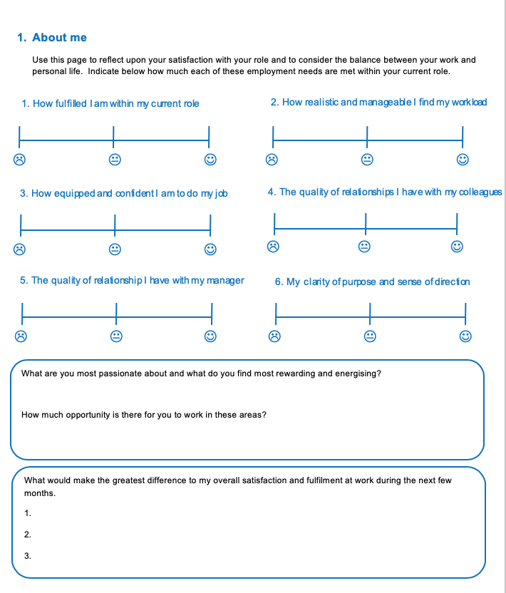
Understanding your people
Understand the individual’s preferences
Make it person-centred
Notice their behaviour and reflections
Check in on how this impacts on other components of the conversation

Slide 18
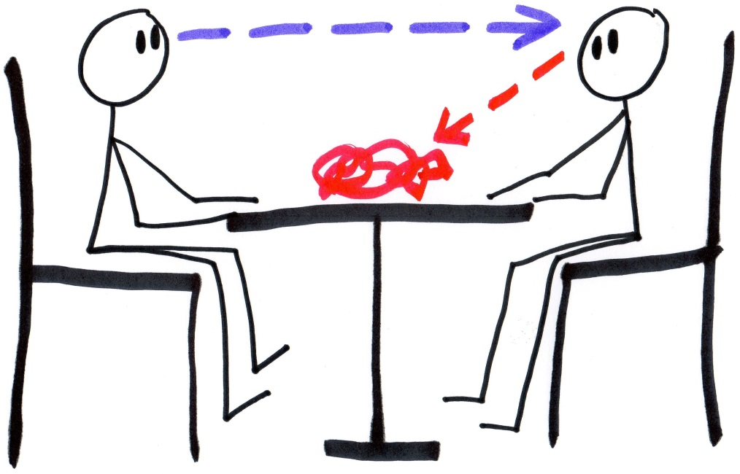
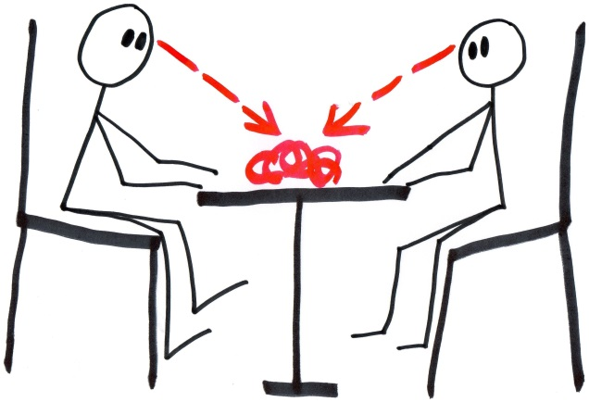
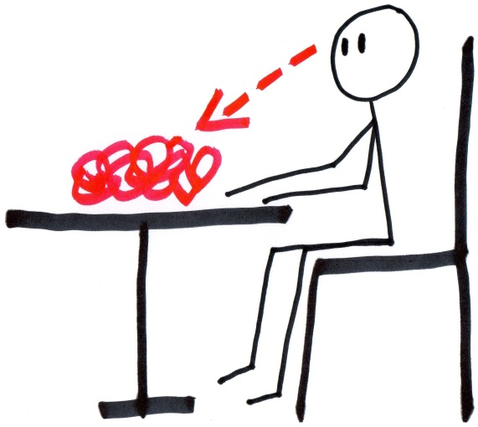
Focus the conversation on them!

Slide 19
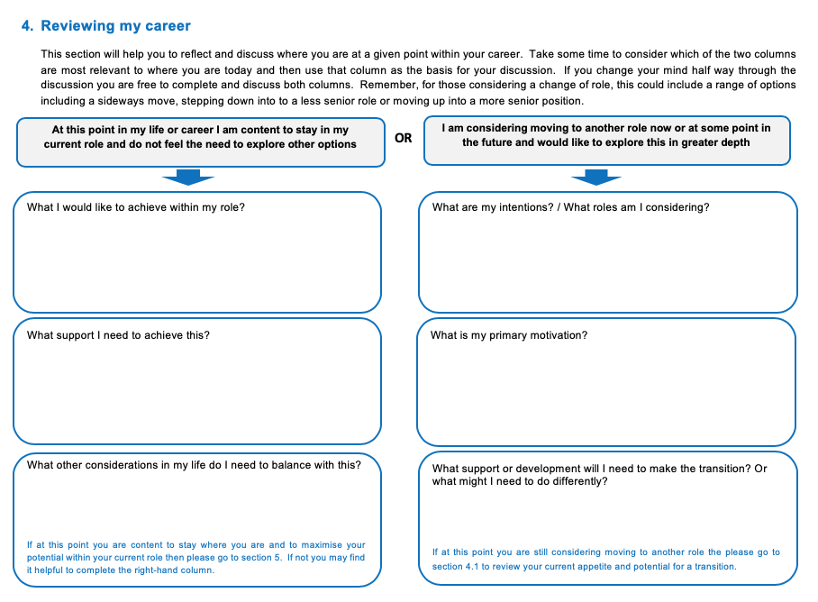
Understanding aspirations

Slide 20

Career (and life) stages
Exploration
Establishment
Maintenance
Advancement
Change
Crisis
Retraction
Retirement

Slide 21

Appreciating difference
People want different things
People can change over time
You’ll encounter different attitudes to these conversations
You’ll need to tailor the conversation to the individual

Slide 22
Performance
Balance what they do, with how they do things
Don’t just use values – use behaviours - describe what good (and not good) means
Use opportunity to praise strengths and support areas for development
Connect behaviour to aspirations

Slide 23
Practice
Think about one of your team members
Identify the behaviours you would like to praise them for
Identify the behaviours you want them to change/improve
Rate them and provide an example of effective/ineffective evidence
What could the impact be if this behaviour does not change?

Slide 24

Potential and readiness
Potential is having or showing capacity to develop in the future
Current performance does not guarantee future success
Encourage development of self-insight
Not a static or stable characteristic
Remember to support the individual with tests of readiness

Slide 25

Ratings
✓
✓
✓
✓
✓
‘give them the benefit
of the doubt’
‘If in doubt mark
them down’
‘play it safe’
... Which one are you?

Slide 26
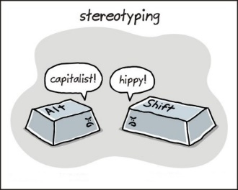
Sources of error
Halo and horns
Central tendency
Leniency
Harshness
First impressions
Recency
Stereotyping
Rushed decision making
Lack of concentration
Similarity/attractiveness

Slide 27

Use evidence
Focus on what you see and hear the person doing or saying
Base your evidence on observed behaviour
Record examples of:
  what they have saying
  how they said it
  what they did
  How they did it
Use quotes/feedback where possible

Slide 28
Lunch

Slide 29

Giving feedback
Feedback is communication which provides useful information about their behaviour and its effect on others
It enables people to make better choices in their future and is essential to learning

Slide 30
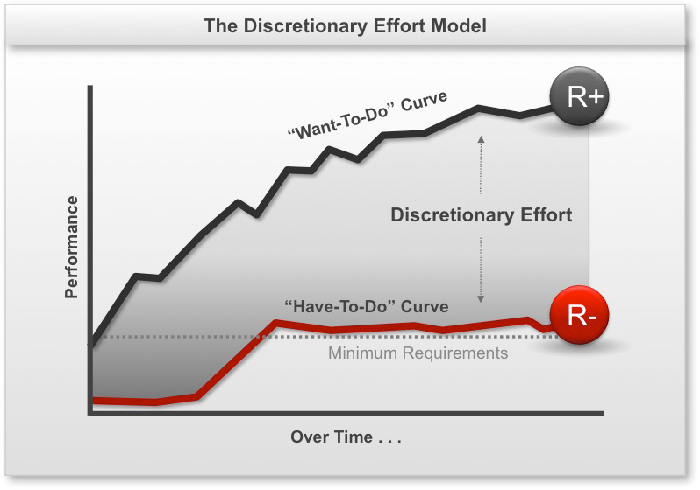
Discretionary Effort
“…..making clear the line of sight from individual to corporate objectives can improve discretionary effort by up to 28 per cent, and giving fair and accurate feedback by up to 39 per cent.”
Roebuck 2011

Slide 31
Johari window
IDENTITY
Known by self
Unknown by self
Known by others
REPUTATION
Open
Blind-spot
feedback
disclosure
Hidden/
Private
Unknown
Unknown by others

Slide 32
Target model for feedback
Behaviours
Self-esteem
Inner Self
Self-esteem
Behaviours

Slide 33
Responses to feedback
SARA
Surprise
Annoyance
Rationalisation
Acceptance

Slide 34

Useful Models: BEER
BEER
Behaviour
Effect
Expectation
Result

Slide 35
BEER
TELL approach
B Behaviour – this is what I saw
E Effect - this is the effect it had on people
E Expectations – this is what I expect from you
R Result – this will be the result if you do/do not change
ASK approach
B Behaviour – this is what I saw
E What effect do you think this has?
E What do you think I expect?
R What result would that give us if you changed that behaviour?

Slide 36

Difference in your team?
Content?
Ambitious?
Newly qualified?
Disengaged?
Disgruntled?
Best friend forever?
Master of illusion?
Self-promoting?
Self-critical?

Slide 37

Feedback summary
Think about how you want the feedback to land
BEER may be to blunt/specific – other frameworks are available!
Bigger issues will need more time
Consider what might be below the iceberg
Plan your feedback carefully

Slide 38
Prepare and Practice!
Identify a team member and select a behaviour from the framework you need to give them feedback on
What do you want this person to do differently?
Structure some BEER feedback (choose between ask and tell – which is most appropriate?
Try your conversation out with a partner

Slide 39
Feedback tips
Be clear
Make it specific – give examples
Own the feedback
Be timely
Vary your approach according to the receiver
Don’t overload the receiver
Don’t keep repeating the same message
Check your feedback has been understood

Slide 40
Making connections
Org vision
Departmental Plans
Team objectives
Individual goals

Slide 41
Considerations with goal setting
What are the key deliverables for your service this year?
What does that mean for your team?
What specifically could a member of your team do that would contribute to achieving this?

Slide 42

Practice
Work in pairs to have a go at writing a work or development goal for a team member that links to a team/departmental plan
Use a framework that works for you
S - Specific
M - Measurable
A - Agreed
R - Realistic
T - Time-bound

Slide 43
Break

Slide 44

Development planning
Consider skills, knowledge and behaviours
Be mindful of the individual’s wants and needs
What’s required to achieve the goals that have been set?
How could this best be achieved?

Slide 45
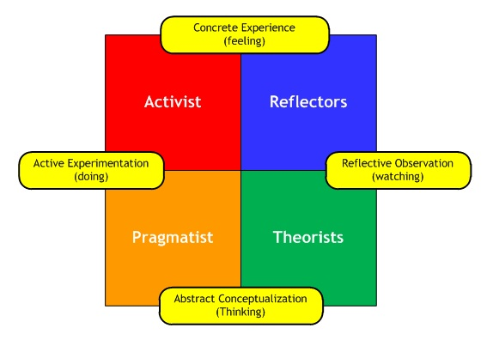
Learning styles

Slide 46

Development options
Reading
Shadowing a role model
Acting as a role model
Clinical supervision
On-line resources
Journals
Networking
Conferences
Projects
Coaching
Mentoring
Learning sets
“Act as if…..” sessions
Reflective practice
Learning journal
Acting up
Covering for holidays
Secondments
Specialist briefings
Speak to experts
Meetings
DVDs
Visits to external organisations

Slide 47
Development planning - practice
Use one of the objectives you created on your table
WHAT - Speculate on what skills, knowledge or behaviour might need to be developed in order to deliver against that objective
HOW - Identify at least 2 different ways for that development to happen

Slide 48
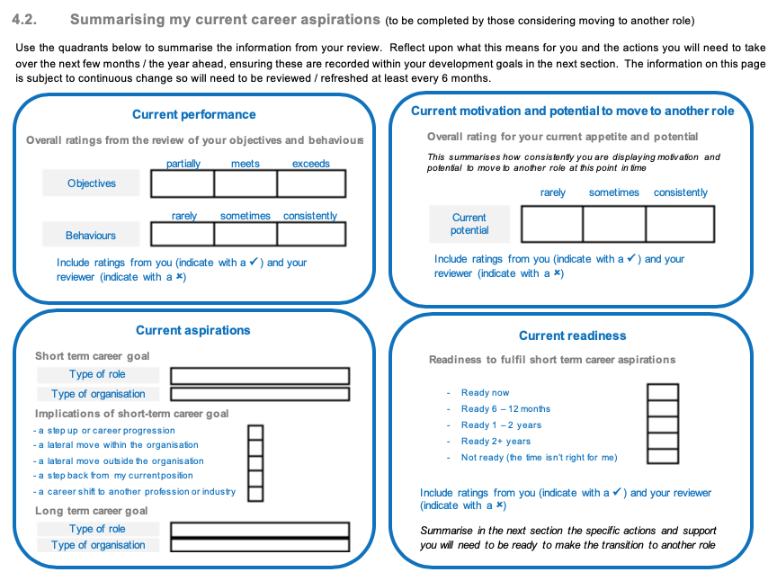
Summarising and monitoring

Slide 49
Tips
The quality of the conversation is paramount
Take time to understand your staff
Preparation and follow up are key
It should be a continuous process
Needs will change
Call on others for support

Slide 50

Your questions, take aways & next steps

Slide 51
Thank you

